Slide 1
Lesson 9
Tactical Casualty Movement

Slide 2
TASK
Conduct tactical casualty movement
Conditions
Given a written situation concerning a tactical casualty movement situation and possible responses
STANDARDS
Select the correct response based upon instruction given in Subcourse IS0871

Slide 3
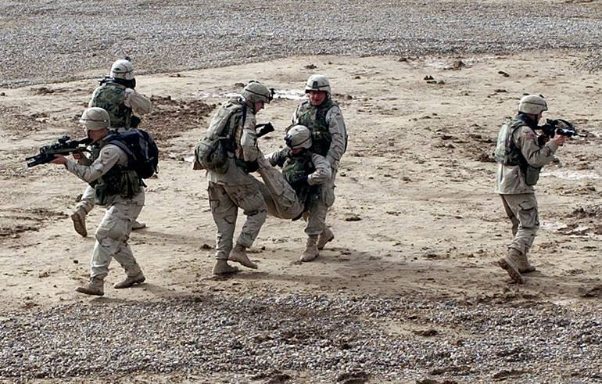
Tactical Casualty Movement

Slide 4
Importance of Rescue
Medical vs. Rescue
In many instances we can not treat until an extraction is performed.
Statistically very dangerous.
Targeting Rescuers
Ratio of rescuers to victims?

Slide 5
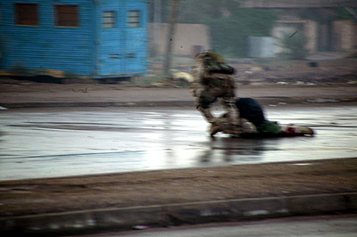
1) While under fire and without a weapon, Gunnery Sgt. Ryan P. Shane runs to Sgt. Lonnie Wells, a downed Marine to pull him to safety during combat operations as part of Operation Al Fajr in Fallujah on Nov. 9.

Slide 6
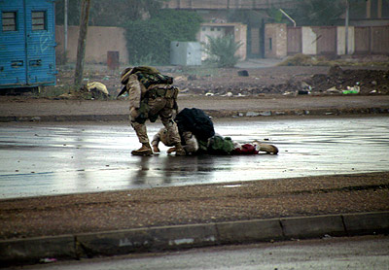
2) Gunnery Sgt. Ryan P. Shane attempts to pull a fatally wounded Marine to safety while under fire. Seconds later Shane was also wounded by enemy fire.

Slide 7
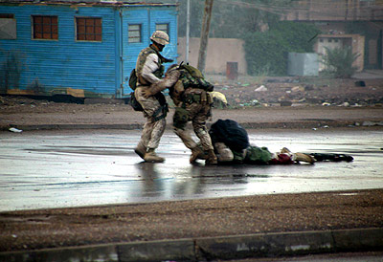
3) Gunnery Sgt. Ryan P. Shane (center) and another member of the 1st Battalion, 8th Marine Regiment, attempt to pull a fatally wounded Marine to safety.

Slide 8
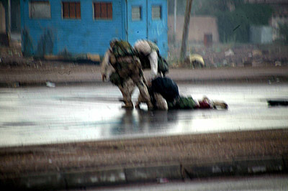
4) Gunnery Sgt. Ryan P. Shane, foreground at left, and another member of the 1st Battalion, 8th Marine Regiment, attempt to move a fatally wounded Marine to safety. Seconds later Shane was also wounded by enemy fire.

Slide 9
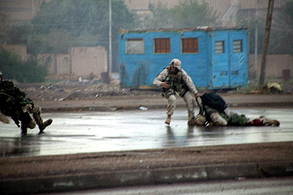
5) Gunnery Sgt. Ryan P. Shane, left, is hit by enemy fire as he and another member of the 1st Battalion, 8th Marine Regiment try to pull fatally wounded Marine to safety.

Slide 10
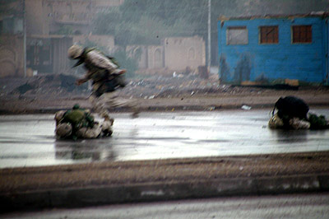
6) The unidentified Marine runs for cover after Gunnery Sgt. Ryan P. Shane, on ground at left, was hit by insurgent sniper fire.

Slide 11
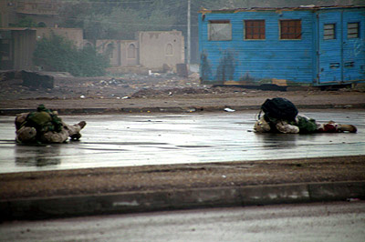
7) Gunnery Sgt. Ryan P. Shane, left, lies wounded after being hit by enemy fire while trying to pull a fatally wounded Marine, right, to safety.

Slide 12
Introduction
Casualty movement on the battlefield is often a complex, problem-solving process
Occurs in all types of terrain and combat environments
Must be appropriate for the tactical situation
Tactical Casualty Movement (TCM) includes;
Individual Movement Techniques (IMT)
Drags
Manual carries
Litter carries

Slide 13
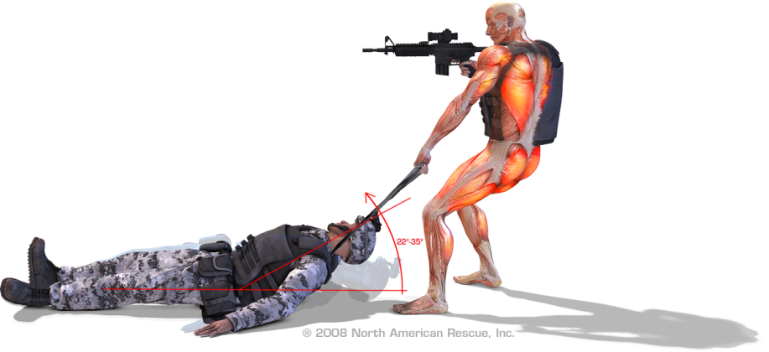
Tactical Casualty Movement
During High Threat Extraction the basic fundamentals we must concentrate on…
Eliminating or at minimum effectively suppressing the threat.
Maximum utilization of resources either organic or improvised.
Synchronize & coordinate the rescue effort.

Slide 14
Tactical Casualty Movement
The tactical leader (SL, PSG or PL) on the ground must direct or be aware TCM is occurring
Integrates TCM into overall tactical situation
Tactical Leader can provide support to protect rescuer and casualty
Establish effective suppressive fire
Prudent utilization of obscurants (smoke)
Implementation of vehicle cover

Slide 15
Individual Movement Techniques
Casualties should move on their own when medically and tactically appropriate
Includes;
Low Crawl
High Crawl
3 to 5 Second Rushes
Walking

Slide 16
Individual Movement Techniques
Allows tactical leaders to keep non or minimally injured Soldiers engaged in the fight
Rescuers maintain weapon readiness
Allows medics and combat life-savers to focus attention on more seriously injured casualties

Slide 17
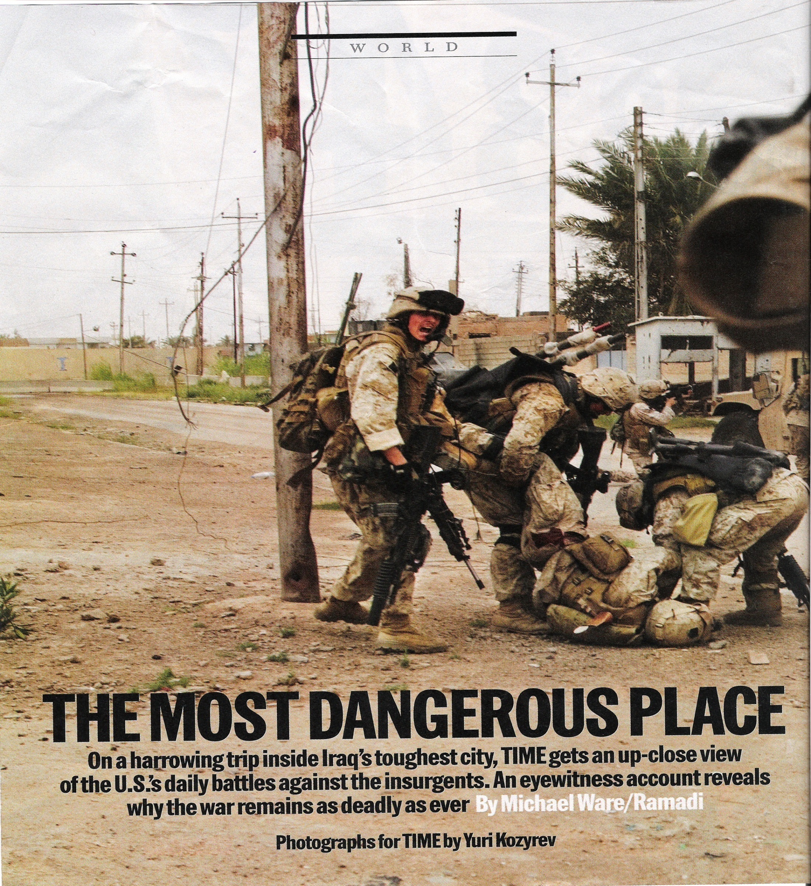

Slide 18
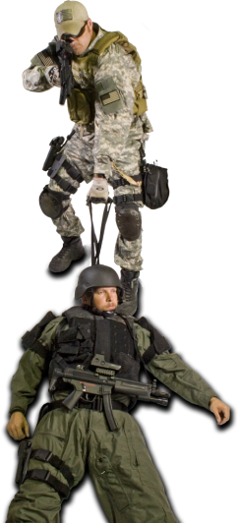
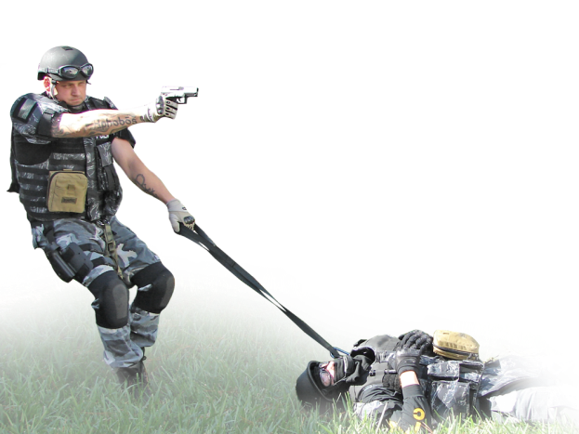
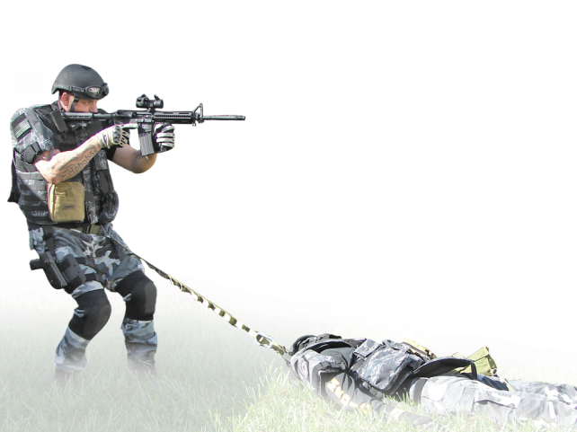
Drags
Handle system
Fast hook up
Exponentially increases speed of rescue

Slide 19
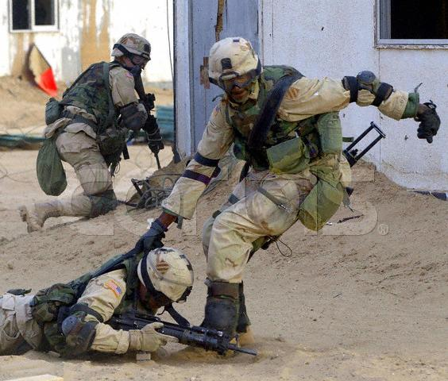
Drag Techniques
Ideal for short distances during tactical engagements
Advantages
Casualty maintains low profile
1-handed methods allow rescuer to maintain close-quarter firing ability with free hand
Heavy casualties that cannot be carried may be dragged

Slide 20
Drag Techniques
Disadvantages
Only for short distances
Still requires significant strength to drag a fully-loaded casualty
Rescuer maintains a high profile
Where and how do you grab?

Slide 21
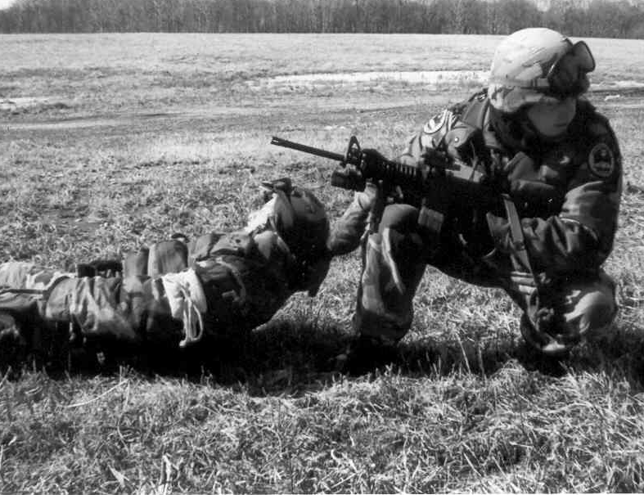
One-Person Drag
Crouching decreases profile
Free hand to engage targets
Single rescuer requires more strength & work resulting in rescuer fatigue and difficulty moving casualty.
Crouch
Weapon Ready

Slide 22
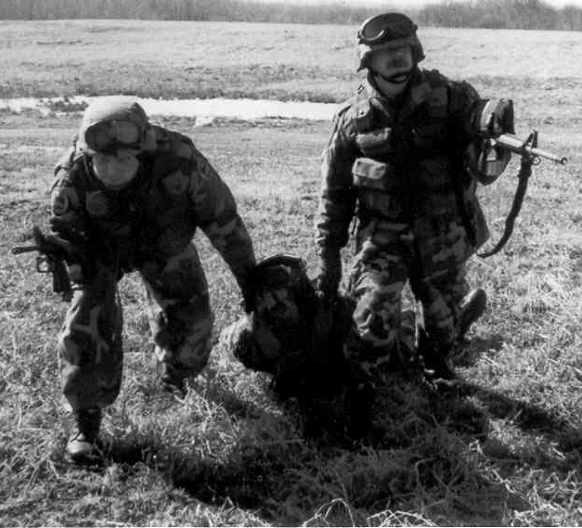
Two-Person Drag
Rescuers have a high profile, but may crouch to decrease profile
Both have a free hand to engage targets
Using 2 rescuers requires less strength & work resulting in less rescuer fatigue.
Crouch
Weapons Ready

Slide 23
Drag Accessories
Dragon Harness
Dragon Handle
Rat Strap
(Rescue Assault Tether)

Slide 24
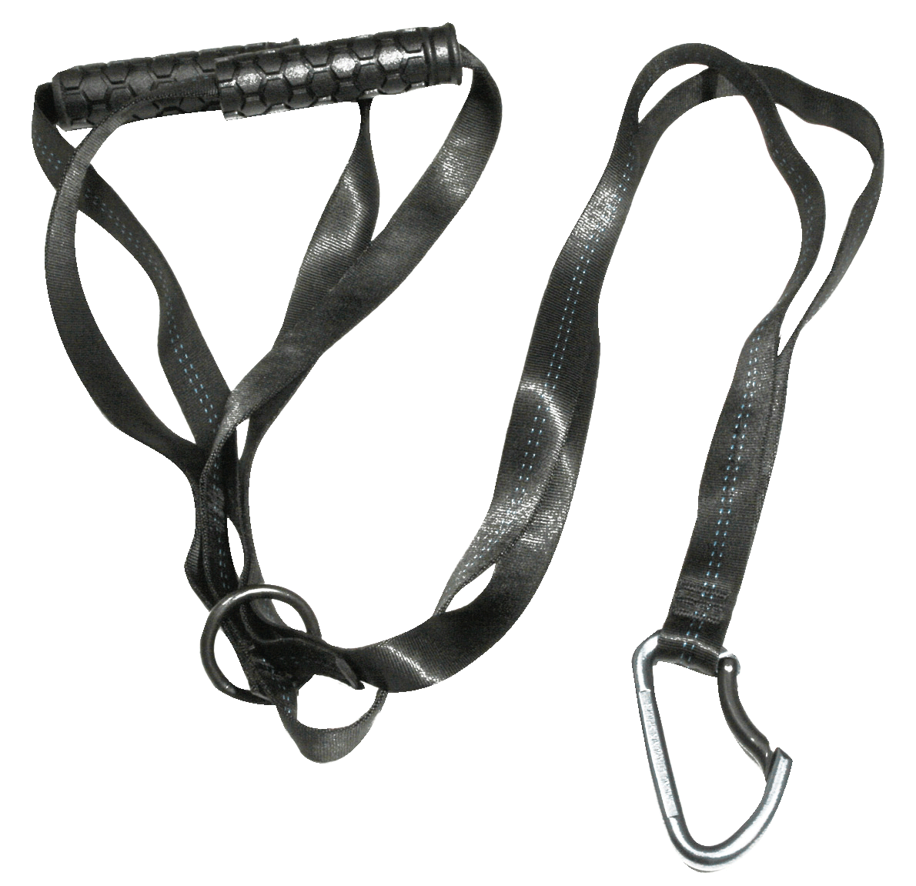
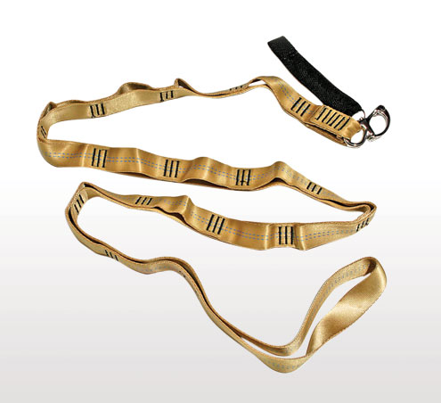
Drag Straps and Lines
Manufactured ( i.e. Dragon Harness, Dragon Handle, or Rat Strap )
Field expedient with rope and snap-link
Provides mechanical advantage over dragging by hand
Used with single or multiple rescuers

Slide 25
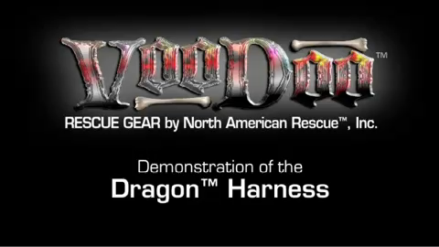
Dragon Harness®

Slide 26
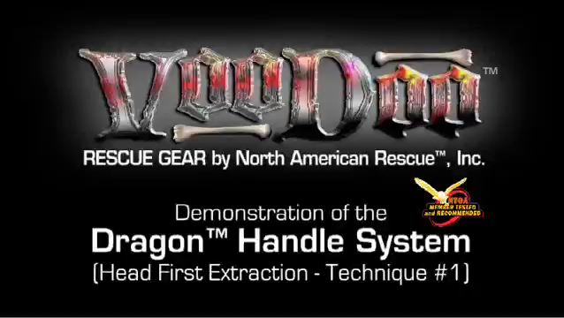
Dragon Handle®

Slide 27
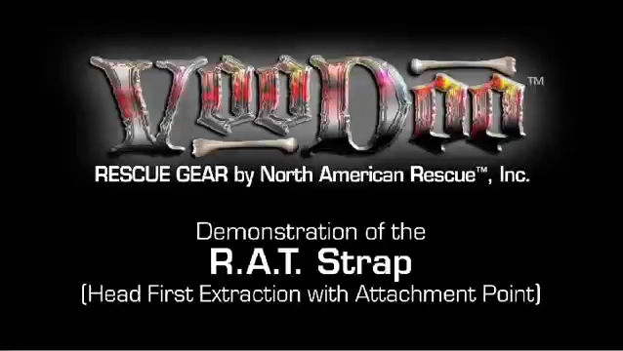
RAT Strap®

Slide 28
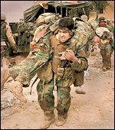
Manual Carries
Physically demanding
Tactical Situation will dictate type of carry

Slide 29
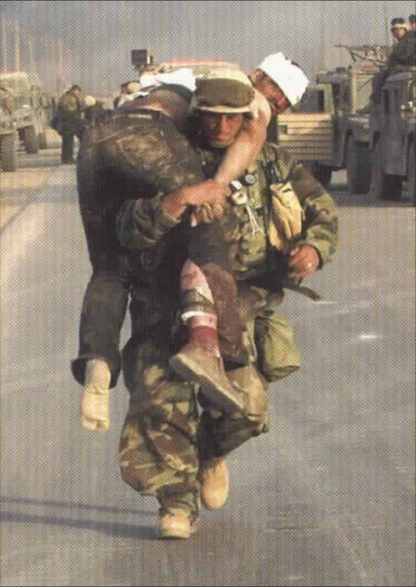
Fireman’s Carry
High center of gravity (CG) increases the chance of falling over
May allow free hand for weapon readiness
CASUALTY: light without armor
RESCUER:
larger, stronger
Weapon Hand Available

Slide 30
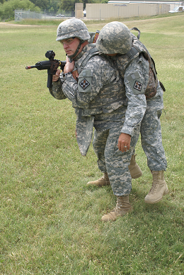
Hawes Carry
More appropriate for tactical situations
Easier to move if conscious and have use of one arm but can be used for unconscious

Slide 31
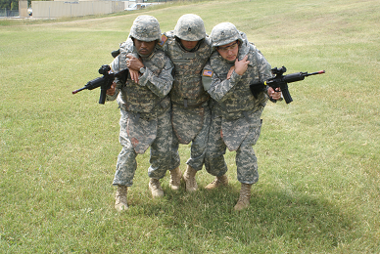
Two Man Supporting Carry
Conscious or unconscious casualty
No rescuer use of weapons with unconscious casualty
Less rescuer fatigue due to shared load
Neck flexion may close airway; consider NPA if unconscious

Slide 32
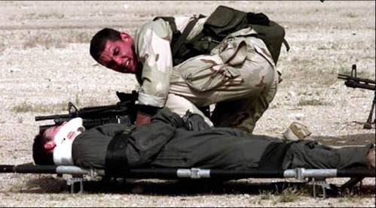
Questions?

